Slide 1


Annexes guidelines and data to be collected
7-9 October 2025 - Sarajevo

Slide 2
Agenda Introduction Presentation of the 6 annexes (data to be collected and how to report) Summary of data to be collected

Slide 3


Introduction
Objective: facilitating the QA/QC of submissions and the preparation of the Energy Community inventory:
Implementation of review recommendations (art.10)
Methodological descriptions (art.11)
Uncertainty analysis (art.12.1)
Reporting on indicators (art.13)
Consistency with ‘EC information’ (art.14 on EU ETS, adapted)
Consistency with energy statistics (art.17)
Templates provided by EEA and under Excel format.

Slide 4
Presentation of the annexes

Slide 5
Annex VIII. Implementation of review recommendations (art.10)

Slide 6

Annex VIII. Implementation of review recommendations General objective and overview of data to be collected
Report on the status of implementing recommendations from past GHG inventory reviews.
Two tables:
Progress on recommendations from the latest UNFCCC review.
Progress on technical corrections/revised estimates or othe issues from the most recent QA/QC checks completed by EEA.
→ Documents to collect:
Latest UNFCCC inventory review.
Latest EEA QA/QC.
→ Key information to gather
List of recommendations and associated details
CRT Category,
Chapter/section in the NID
Response status.
• UNFCCC review on BTR planned in 2025, possible recommendations made on the BUR technical analysis.
• For now, no Energy Community – internal QA/QC.
Notes:
For any recommendation that has not been implemented, include an explanation of the reasons why it has not been carried out.

Slide 7
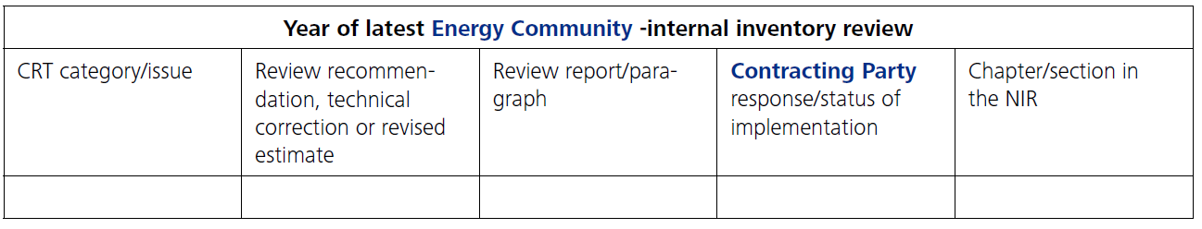
Annex VIII. Implementation of review recommendations Analyzing collected data and how to report
Same template structure for table 1 and 2
UNFCCC
Energy Community - internal

Slide 8
Annex IX. Methodological descriptions (art.11)

Slide 9
Annex IX. Methodological descriptions General objective and overview of data to be collected
Document on inventory methods, emission factors, and methodological descriptions for key categories.
Table with four parts in the annex:
First two parts prefilled by the EEA when details are available in the last Party’s NIDs.
Part 3 and 4 need to be updated as necessary according to information available in the current submission (by 15 January and 15 March) by the Parties
→ Documents to collect:
Current country inventory (CRT, NID / other methodological documents / calculation files).
→ Key information to gather
For each emissions source,
Methodology used,
Activity data,
Emission factor
Notes:
all methodological information related to Contracting Parties inventory: inventory methods (T1 / T2 / T3), emission factors and methodological descriptions used to estimate the emissions of CP’s key categories. Key categories are those with significant contributions to emissions or removals and are prioritized for accuracy and detail.
The first two parts are prefilled by the Secretariat when details about inventory methods, emission factors and summary methodological descriptions are available in the last CP’s NIDs.
Part 3 and 4 need to be updated as necessary by the Contracting Party according to information available in the current submission

Slide 10
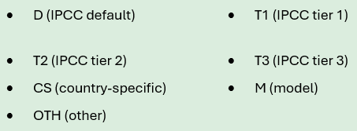
Annex IX. Methodological descriptions Analyzing collected data and how to report
Notation Keys to be used for methods and EFs
PRE-FILLED BY THE SECRETARIAT

Slide 11
Annex IX. Methodological descriptions Analyzing collected data and how to report

Slide 12
Annex X. Uncertainties and completeness (art.12)

Slide 13
Annex X. Uncertainties General objective and overview of data to be collected
Report uncertainty calculations for each IPCC category.
Adapted Table 3.2 from the 2006 IPCC guidelines
→ Documents to collect:
Inventory emissions results.
Calculation files for uncertainty estimates.
→ Key information to gather
For each IPCC category and and greenhouse gas
Emissions in Gg CO₂e (base year and current year)
Uncertainties percentage for emission factors
Uncertainties percentage for activity data
If emission uncertainties have already been calculated: results of uncertainties (e.g. one sectoral implementation of Monte Carlo tier2 uncertainty approach)
Do not hesitate to use the Guidance from the 2006 IPCC guidelines, Vol. 1. (Approach 1).
Notes:
If uncertainties have already been calculated/reported: calculation files.

Slide 14
Annex X. Uncertainties Analyzing collected data and how to report

Slide 15
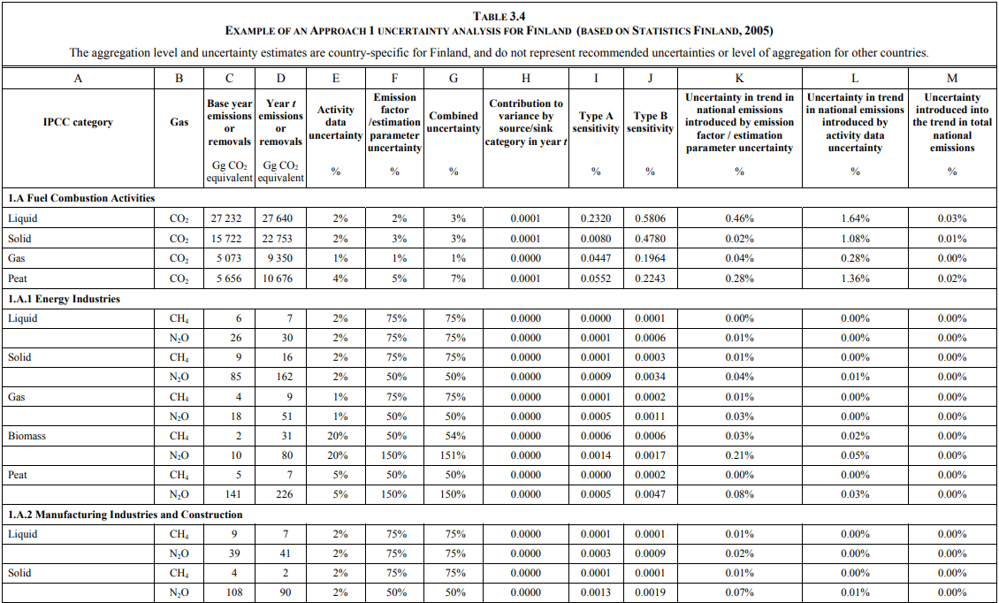
Example

Slide 16
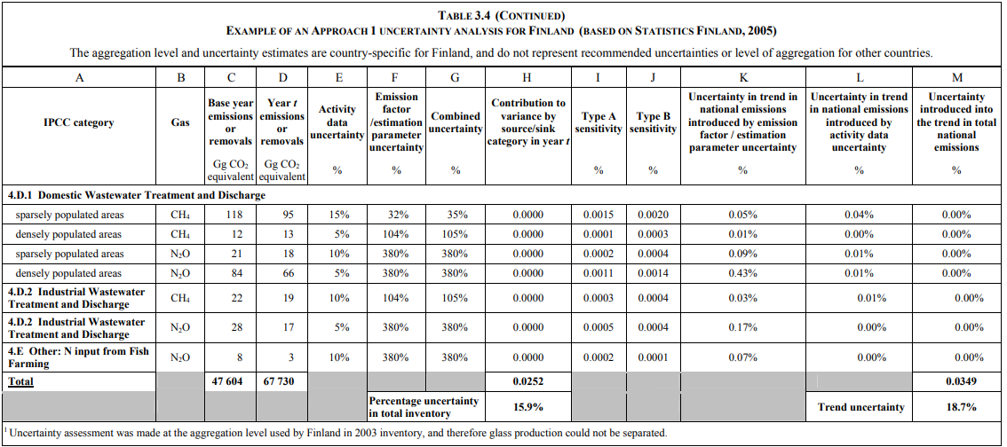
Example

Slide 17
Annex XI. Reporting on indicators (art.13)

Slide 18
Presentation : the 11 indicators
Sector | Indicator | Unit
Transformation | Specific CO₂ emissions of public and auto-producer power plants | t/TJ
Transformation | Specific CO₂ emissions of auto-producer plant | t/TJ
Industry | Total CO₂ intensity - iron and steel industry | t/million €
Industry | Energy-related CO₂ intensity - chemical industry | t/million €
Industry | Energy-related CO₂ intensity - glass, pottery and building materials industry | t/million €
Industry | Energy-related CO₂ intensity - food, drink and tobacco industry | t/million €
Industry | Energy-related CO₂ intensity - paper and printing industry | t/million €
Households | Specific CO₂ emissions of households for space heating | kg/m²
Services | Specific CO₂ emissions of commercial and institutional sector for space heating | kg/m²
Transport | Specific diesel related CO₂ emissions of passenger cars | g/km
Transport | Specific petrol related CO₂ emissions of passenger cars | g/km

Slide 19
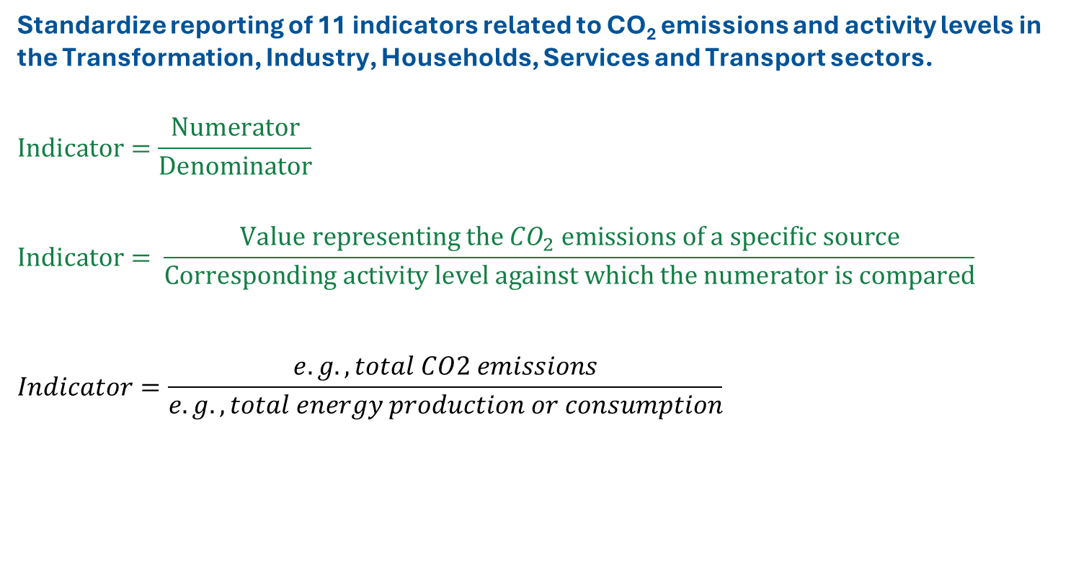
Annex XI. Reporting on indicators General objective
Standardize reporting of 11 indicators related to CO₂ emissions and activity levels in the Transformation, Industry, Households, Services and Transport sectors.
$$Indicator=\frac{Numerator}{Denominator}$$
$$Indicator= \frac{Value representing the {CO}_{2} emissions of a specific source}{Corresponding activity level against which the numerator is compared}$$
$$Indicator=\frac{e.g., total CO2 emissions}{e.g., total energy production or consumption}$$

Slide 20
Annex XI. Reporting on indicators Analyzing collected data and how to report
General guidance
Identification of the indicator
Numerator / Denominator
1
2
Follow guidance and definitions indicated in column E of the annex
Collect relevant data for Year X – 2
Notes:
Key categories are those with significant contributions to emissions or removals and are prioritized for accuracy and detail.

Slide 21
Annex XI. Reporting on indicators Analyzing collected data and how to report
→ Documents to collect:
National Energy Statistics Reports
GHG emissions Inventory and calculations files
Sectoral statistics
→ Key information to gather
CO₂ emissions due to combustion of fossil fuels by relevant category.
Sectoral activity data :
Transformation sector: Energy production for electricity and heat production, by type of producers
Industry sector: Gross-added value by relevant sub-category
Household and Services sectors: Surface area of buildings
Transport sector: Vehicle kilometres of passenger cars
Notes:
Only CO2 emissions

Slide 22
Key information to gather – Transformation sector
CO₂ emissions | Activity levels | Source
• Energy balance by fuel for electricity and heat production by public and auto-producer thermal power and combined heat and power plants • EF_{CO2} = Emission factors for CO₂, for each fuel | Gross electricity produced and any heat sold to third parties by: public thermal power and CHP auto-producer thermal power and CHP. (Heat only plants are not included) | • Energy balance • Central Bureau of Statistics • GHG Inventory / IPCC Guidelines
Notes:
Energy production for electricity and heat production by type of producers:

Slide 23
Key information to gather - Industry
CO₂ emissions | Activity levels | Source
Emissions of specific source categories due to the combustion of fossil fuels for the manufacture, and for the generation of electricity and heat: • Iron and steel (1A2a + 2C1 + 2C2). • Chemical (1A2c) • Glass, pottery and building materials (1A2f) • Food, drink and tobacco (1A2e) • Paper and printing (1A2d) | Gross-added value by relevant sub-category according to the NACE classification (Rev. 1) • Iron and steel: NACE 27.1; 27.2; 27.3; 27.51; 27.52. • Chemicals and chemical products: NACE 24 • Non-metallic mineral products: NACE 26 • Food products and beverages: NACE 15; tobacco products: NACE 16 • paper and printing: NACE 21 and 22 | • GHG Inventory • National Accounts • Central Bureau of Statistics
Notes:
2A4: Other Processes Uses of Carbonates | 2A4d: Other (please specify)
2A5 : Other

Slide 24
Key information to gather – Household sector
CO₂ emissions | Activity levels | Source
• Fuel consumption by type of fuel, used in households only for space heating. • EF_{CO2} = Emission factors for CO₂, for each fuel type | Total surface area of permanently occupied dwelling. If not available: • Average surface area of main residence housing (m²) • Permanently occupied housing stock (number of units) | • GHG Inventory / IPCC Guidelines • Central Bureau of Statistics • National Housing entity
Notes:
Energy production for electricity and heat production by type of producers:

Slide 25
Key information to gather – Services sector
CO₂ emissions | Activity levels | Source
• Fuel consumption by type of fuel, used in commercial and institutional buildings in the public and private sectors and only for space heating. • EF_{CO2} = Emission factors for CO₂, for each fuel type | Total surface area of services buildings (NACE 41, 50, 51, 52, 55, 63, 64, 65, 66, 67, 70, 71, 72, 73, 74, 75, 80, 85, 90, 91, 92, 93, 99). | • Central Bureau of Statistics • GHG Inventory / IPCC Guidelines
Notes:
Energy production for electricity and heat production by type of producers:

Slide 26
Key information to gather – Transport sector
CO₂ emissions | Activity levels | Source
• CO₂ emissions from the combustion of diesel / petrol for all transport activity with passenger cars – IPCC source category 1A3bi only diesel / only petrol) | Number of vehicle kilometers of total diesel / petrol-driven passenger cars licensed. If not available: • Number of vehicle kilometers of total passenger cars • Share of diesel/petrol-driven passenger cars | • GHG Inventory • Central Bureau of Statistics • Transport statistics
Notes:
Energy production for electricity and heat production by type of producers:

Slide 27
Annex XII. Consistency with ETS (art.14)

Slide 28
Annex XII. Consistency with ETS General objective and overview of data to be collected
Compare GHG inventory emissions with verified emissions under the European Trading Scheme (ETS).
The annex calculates automatically the difference between inventory emissions and verified ETS emissions.
→ Documents to collect:
GHG inventory.
Verified emissions data from ETS.
→ Key information to gather
Emissions by IPCC category and sub-category
Not to be reported under the current situation. Might become relevant in the future

Slide 29
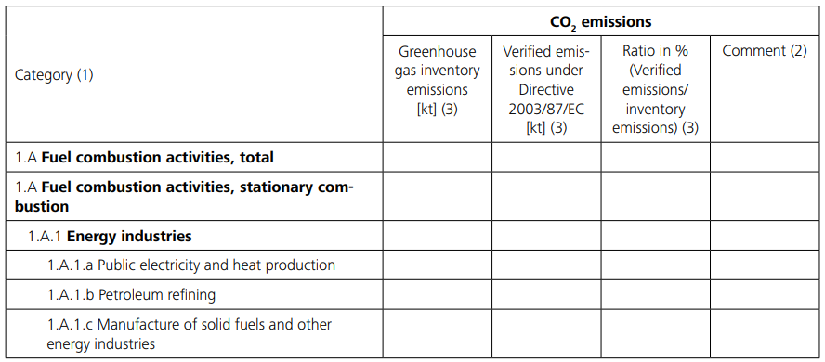
Annex XII. Consistency with ETS Analyzing collected data and how to report
Automatically calculated
CPs must explain the differences

Slide 30
Annex XIV. Consistency with Energy Statistics (art.17)

Slide 31
Annex XIV. Consistency with Energy Statistics General objective and overview of data to be collected
Compare fuel consumptions reported in the reference approach in the GHG inventory with the consumption reported pursuant to Regulation (EC) No 1099/2008 – i.e. submitted and published on EuroStat
The annex calculates automatically, the absolute difference (in TJ) and the relative difference (in %) between the two.
→ Documents to collect:
GHG Inventory
Eurostat
→ Key information to gather
Fuel consumption by type of fuel (in TJ) used in the GHG Inventory
“Gross inland consumption” by type of fuel (in TJ) submitted and published on Eurostat
If the fuel consumption file submitted and published on Eurostat is not available, it can be downloaded from EuroStat database.
Database - Eurostat

Slide 32
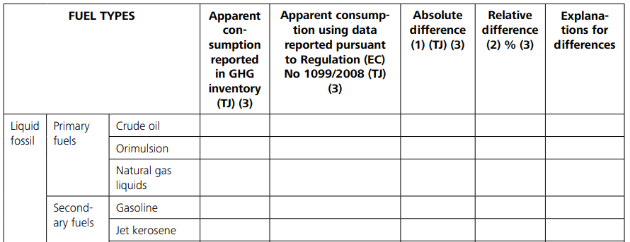
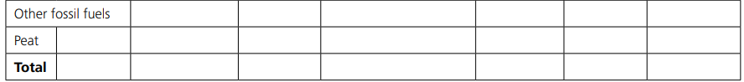
Annex XIV. Consistency with Energy Statistics Analyzing collected data and how to report
Automatically calculated
CPs must explain deviations exceeding ±2% on the total apparent fuel consumption (focus on the main categories impacting most the 2% difference.

Slide 33
Summary of documents and data to be collected

Slide 34
Documents needed
→ Documents to collect (if available):
Last GHG Inventory (CRT tables, NID / other methodological documents / calculation files)
Latest UNFCCC and EU inventory review reports
Calculation files for uncertainty estimates
Sectoral documents
Eurostat “Gross Inland consumption” by type of fuel (in TJ)
Notes:
Key categories are those with significant contributions to emissions or removals and are prioritized for accuracy and detail.

Slide 35
Data to identify
→Key information to gather:
For each emissions source,
Emissions in Gg CO₂e by category and gas (for different years)
Methodology used,
Corresponding Activity data and Emission factor
CO₂ emissions due to combustion of fossil fuels by relevant category (see annex XI - Indicators).
If not available:
Fossil fuel consumption in the relevant category
CO₂ emission factor for the relevant type of fossil fuel and category
Fuel consumption by type of fuel (in TJ) used in the GHG Inventory
Uncertainties percentage for emission factors and activity data, per IPCC category and greenhouse gas
Sectoral activity data (see annex XI for specific details).
Transformation sector: Energy production for electricity and heat production, by type of producers. (see annex XI).
Industry sector: Gross-added value by relevant sub-category
Household and Services sectors: Surface area of buildings
Transport sector: Vehicle kilometers of passenger cars
Know how to identify in the inventory files
Know how to identify
Notes:
Key categories are those with significant contributions to emissions or removals and are prioritized for accuracy and detail.

Slide 36

Thank you
Jean-pierre.chang@citepa.org
Julien.vincent@citepa.org
42 rue de Paradis 75010 Paris
01 44 83 68 83
infos@citepa.org
citepa.org

